Slide 1
Inheritance

Slide 2
Objectives
To define a subclass from a superclass through inheritance
To invoke the superclass’s constructors and methods using the super keyword
To override instance methods in the subclass
To distinguish differences between overriding and overloading
To learn about protected and package access control
To understand the common superclass Object and how to override its toString and equals methods

Slide 3
Inheritance Relationship
The inheritance relationship can be viewed as a relationship between an object category and its subcategories.
For example...

Slide 4
Inheritance Relationship
Transport

Slide 5
Inheritance Relationship
Transport
Air Transport

Slide 6
Inheritance Relationship
Transport
Air Transport
Sea Transport

Slide 7
Inheritance Relationship
Transport
Air Transport
Sea Transport
Land Transport

Slide 8
Inheritance Relationship
The inheritance relationship is sometimes called the “is-a” relationship.
For example...

Slide 9
Inheritance Relationship
Transport
Inheritance Relationship
Sea Transport
Land Transport
Air Transport
Sea Transport
object “is a”
Transport object
Land Transport
object “is a”
Transport object
Air Transport
object “is a”
Transport object

Slide 10
Inheritance Relationship
Based on the meaning of the “is-a” relationship, each object will have attributes and behaviour as defined by its category and all its supercategories.
An inheritance hierarchy can be built through generalization or specialization.

Slide 11
Inheritance Relationship
Transport
speed
getSpeed( )
Attributes
speed
altitude
Air Transport
altitude
fly( )
Behaviour
getSpeed()
fly()

Slide 12
Subclassing
Java supports class inheritance through subclassing.
By declaring a class as a subclass of a base class, an inheritance relationship between those two classes is created.
The Java keyword for this is extends.

Slide 13
Subclassing
class Transport {
}
private int speed;
public Transport (int s) {
speed = s;
}
public int getSpeed() {
return speed;
}
class AirTransport extends Transport {
private int altitude;
:
}
Base class
subclass

Slide 14
Subclassing
class Rectangle {
}
private int width, height;
public Rectangle(int w, int h) {
width = w;
height = h;
}
public int getArea() {
return width * height;
}
class Square extends Rectangle {
}
Base class
subclass

Slide 15
Subclassing
In the example, the Square class is declared as a subclass of the Rectangle class
Each subclass inherits the instance variables and instance methods of its base class.
Note that constructors and private methods ARE NOT INHERITED.
Besides attributes and methods inherited from its base class, a subclass can also define its own attributes and methods.

Slide 16
Superclasses and Subclasses
GeometricObject
Circle
Rectangle
GeomObjArrayList
Run

Slide 17
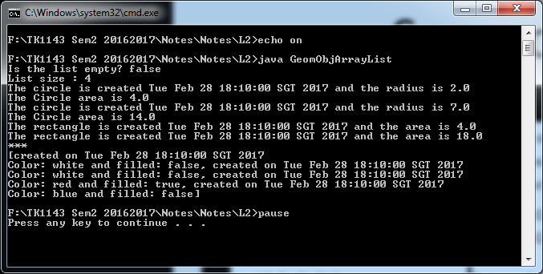
Output

Slide 18
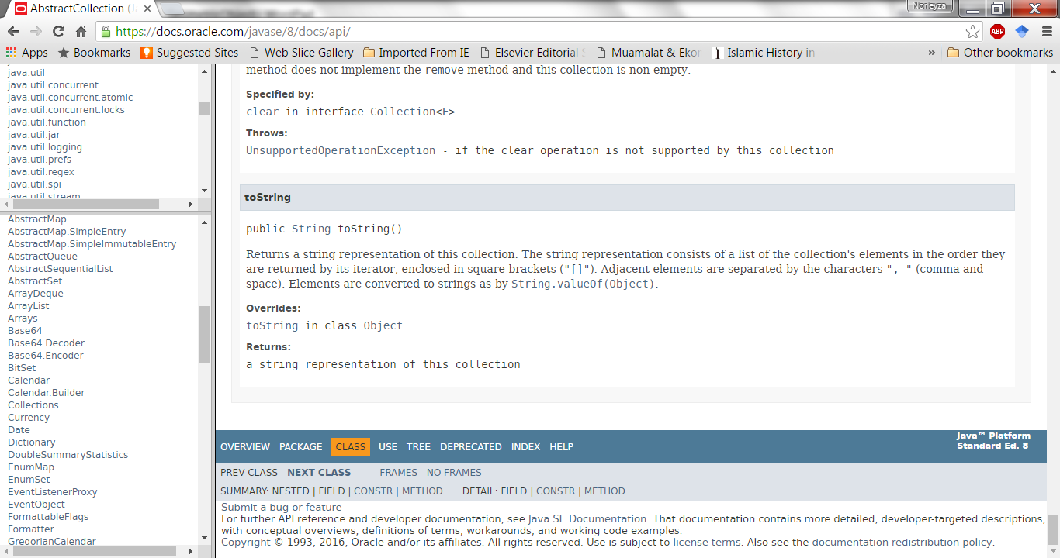
Note the toString() method overriding*
Go back

Slide 19
Are superclass’s Constructor Inherited?
No. They are not inherited. Unlike attributes and public/protected methods.
They are invoked explicitly or implicitly.
Explicitly using the super keyword.
A constructor is used to construct an instance of a class.
They can only be invoked from the subclasses' constructors, using the keyword super. If the keyword super is not explicitly used, the superclass's with no-arg constructor is automatically invoked.

Slide 20
Superclass’s Constructor Is Always Invoked
A constructor may invoke an overloaded constructor or its superclass’s constructor. If none of them is invoked explicitly, the compiler puts super() as the first statement in the constructor. For example,

Slide 21
Using the Keyword super
The keyword super refers to the superclass of the class in which super appears. This keyword can be used in two ways:
To call a superclass constructor
To call a superclass method

Slide 22
Constructors and super()
class Rectangle {
}
private int width, height;
public Rectangle(int w, int h) {
width = w;
height = h;
}
public int getArea() {
return width * height;
}
class Square extends Rectangle {
}
“Calls” the constructor of the Rectangle class
public Square(int size) {
super(size, size);
}

Slide 23
Constructors and super()
class Rectangle {
}
class Square extends Rectangle {
}
private int width, height;
public Square(int size) {
setWidth(size);
setHeight(size);
}
public Rectangle(int w, int h) {
width = w;
height = h;
}
Compiler secretly adds a super()!
public void setWidth(int w) {
width = w;
}
The compiler then displays this error message. Why?
test.java: 16: cannot resolve symbol
symbol : constructor Rectangle ()
location: class Rectangle
public Square(int size) {
^
public void setHeight(int h) {
height = h;
}

Slide 24
CAUTION
You must use the keyword super to call the superclass constructor. Invoking a superclass constructor’s name in a subclass causes a syntax error. Java requires that the statement that uses the keyword super appear first in the constructor.
Although a subclass inherits private attributes from its base class, it has no direct access to them.

Slide 25
Constructor Chaining
Constructing an instance of a class invokes all the superclasses’ constructors along the inheritance chain. (secretly call super()). This is called constructor chaining.
public class Faculty extends Employee {
public static void main(String[] args) {
new Faculty();
}
public Faculty() {
System.out.println("(4) Faculty's no-arg constructor is invoked");
}
}
class Employee extends Person {
public Employee() {
this("(2) Invoke Employee’s overloaded constructor");
System.out.println("(3) Employee's no-arg constructor is invoked");
}
public Employee(String s) {
System.out.println(s);
}
}
class Person {
public Person() {
System.out.println("(1) Person's no-arg constructor is invoked");
}
}

Slide 26
Trace Execution
animation
public class Faculty extends Employee {
public static void main(String[] args) {
new Faculty();
}
public Faculty() {
System.out.println("(4) Faculty's no-arg constructor is invoked");
}
}
class Employee extends Person {
public Employee() {
this("(2) Invoke Employee’s overloaded constructor");
System.out.println("(3) Employee's no-arg constructor is invoked");
}
public Employee(String s) {
System.out.println(s);
}
}
class Person {
public Person() {
System.out.println("(1) Person's no-arg constructor is invoked");
}
}
1. Start from the main method

Slide 27
Trace Execution
animation
public class Faculty extends Employee {
public static void main(String[] args) {
new Faculty();
}
public Faculty() {
System.out.println("(4) Faculty's no-arg constructor is invoked");
}
}
class Employee extends Person {
public Employee() {
this("(2) Invoke Employee’s overloaded constructor");
System.out.println("(3) Employee's no-arg constructor is invoked");
}
public Employee(String s) {
System.out.println(s);
}
}
class Person {
public Person() {
System.out.println("(1) Person's no-arg constructor is invoked");
}
}
2. Invoke Faculty constructor

Slide 28
Trace Execution
animation
public class Faculty extends Employee {
public static void main(String[] args) {
new Faculty();
}
public Faculty() {
System.out.println("(4) Faculty's no-arg constructor is invoked");
}
}
class Employee extends Person {
public Employee() {
this("(2) Invoke Employee’s overloaded constructor");
System.out.println("(3) Employee's no-arg constructor is invoked");
}
public Employee(String s) {
System.out.println(s);
}
}
class Person {
public Person() {
System.out.println("(1) Person's no-arg constructor is invoked");
}
}
3. Invoke Employee’s no-arg constructor

Slide 29
Trace Execution
animation
public class Faculty extends Employee {
public static void main(String[] args) {
new Faculty();
}
public Faculty() {
System.out.println("(4) Faculty's no-arg constructor is invoked");
}
}
class Employee extends Person {
public Employee() {
this("(2) Invoke Employee’s overloaded constructor");
System.out.println("(3) Employee's no-arg constructor is invoked");
}
public Employee(String s) {
System.out.println(s);
}
}
class Person {
public Person() {
System.out.println("(1) Person's no-arg constructor is invoked");
}
}
4. Invoke Employee(String) constructor

Slide 30
Trace Execution
animation
public class Faculty extends Employee {
public static void main(String[] args) {
new Faculty();
}
public Faculty() {
System.out.println("(4) Faculty's no-arg constructor is invoked");
}
}
class Employee extends Person {
public Employee() {
this("(2) Invoke Employee’s overloaded constructor");
System.out.println("(3) Employee's no-arg constructor is invoked");
}
public Employee(String s) {
System.out.println(s);
}
}
class Person {
public Person() {
System.out.println("(1) Person's no-arg constructor is invoked");
}
}
5. Invoke Person() constructor

Slide 31
Trace Execution
animation
public class Faculty extends Employee {
public static void main(String[] args) {
new Faculty();
}
public Faculty() {
System.out.println("(4) Faculty's no-arg constructor is invoked");
}
}
class Employee extends Person {
public Employee() {
this("(2) Invoke Employee’s overloaded constructor");
System.out.println("(3) Employee's no-arg constructor is invoked");
}
public Employee(String s) {
System.out.println(s);
}
}
class Person {
public Person() {
System.out.println("(1) Person's no-arg constructor is invoked");
}
}
6. Execute println

Slide 32
Trace Execution
animation
public class Faculty extends Employee {
public static void main(String[] args) {
new Faculty();
}
public Faculty() {
System.out.println("(4) Faculty's no-arg constructor is invoked");
}
}
class Employee extends Person {
public Employee() {
this("(2) Invoke Employee’s overloaded constructor");
System.out.println("(3) Employee's no-arg constructor is invoked");
}
public Employee(String s) {
System.out.println(s);
}
}
class Person {
public Person() {
System.out.println("(1) Person's no-arg constructor is invoked");
}
}
7. Execute println

Slide 33
Trace Execution
animation
public class Faculty extends Employee {
public static void main(String[] args) {
new Faculty();
}
public Faculty() {
System.out.println("(4) Faculty's no-arg constructor is invoked");
}
}
class Employee extends Person {
public Employee() {
this("(2) Invoke Employee’s overloaded constructor");
System.out.println("(3) Employee's no-arg constructor is invoked");
}
public Employee(String s) {
System.out.println(s);
}
}
class Person {
public Person() {
System.out.println("(1) Person's no-arg constructor is invoked");
}
}
8. Execute println

Slide 34
Trace Execution
animation
public class Faculty extends Employee {
public static void main(String[] args) {
new Faculty();
}
public Faculty() {
System.out.println("(4) Faculty's no-arg constructor is invoked");
}
}
class Employee extends Person {
public Employee() {
this("(2) Invoke Employee’s overloaded constructor");
System.out.println("(3) Employee's no-arg constructor is invoked");
}
public Employee(String s) {
System.out.println(s);
}
}
class Person {
public Person() {
System.out.println("(1) Person's no-arg constructor is invoked");
}
}
9. Execute println

Slide 35
Example on the Impact of a Superclass without no-arg Constructor
Find out the errors in the program:
public class Apple extends Fruit {
}
class Fruit {
public Fruit(String name) {
System.out.println("Fruit's constructor is invoked");
}
}

Slide 36
Defining a Subclass
A subclass inherits from a superclass. You can also:
Add new properties
Add new methods
Override the methods of the superclass

Slide 37
Calling Superclass Methods
You could rewrite the printCircle() method in the Circle class as follows:
public void printCircle() {
System.out.println("The circle is created " +
super.getDateCreated() + " and the radius is " + radius);
}

Slide 38
Overriding Methods in the Superclass
A subclass inherits methods from a superclass. Sometimes it is necessary for the subclass to modify the implementation of a method defined in the superclass. This is referred to as method overriding.
public class Circle extends GeometricObject {
// Other methods are omitted
/** Override the toString method defined in GeometricObject */
public String toString() {
return super.toString() + "\nradius is " + radius;
}
}

Slide 39
NOTE
An instance method can be overridden only if it is accessible.
Thus a private method cannot be overridden, because it is not accessible outside its own class.
If a method defined in a subclass is private in its superclass, the two methods are completely unrelated.

Slide 40
NOTE
Like an instance method, a static method can be inherited.
However, a static method cannot be overridden.
If a static method defined in the superclass is redefined in a subclass, the method defined in the superclass is hidden.

Slide 41
Overriding vs. Overloading

Slide 42
Method Overriding
Consider the following inheritance hierarchy:
D objD = new D();
E objE = new E();
B objB = new B();
objE.doThis();
objD.doThis();
objB.doThis();

Slide 43
The Object Class and Its Methods
Every class in Java is descended from the java.lang.Object class.
If no inheritance is specified when a class is defined, the superclass of the class is Object.

Slide 44
The toString() method in Object
The toString() method returns a string representation of the object.
The default implementation returns a string consisting of a class name of which the object is an instance, the at sign (@), and a number representing this object.
Loan loan = new Loan();
System.out.println(loan.toString());
The code displays something like Loan@15037e5 . This message is not very helpful or informative. Usually you should override the toString method so that it returns a digestible string representation of the object.
toString() method of ArrayList

Slide 45
The equals Method
The equals() method compares the contents of two objects. The default implementation of the equals method in the Object class is as follows:
public boolean equals(Object obj) {
return (this == obj);
}
For example, the equals method is overridden in the Circle class.
public boolean equals(Object o) {
if (o instanceof Circle) {
return radius == ((Circle)o).radius;
}
else
return false;
}

Slide 46
NOTE
The == comparison operator is used for comparing two primitive data type values or for determining whether two objects have the same references.
The equals method is intended to test whether two objects have the same contents, provided that the method is modified in the defining class of the objects.
The == operator is stronger than the equals method, in that the == operator checks whether the two reference variables refer to the same object.

Slide 47
The protected Modifier
The protected modifier can be applied on data and methods in a class. A protected data or a protected method in a public class can be accessed by any class in the same package or its subclasses, even if the subclasses are in a different package.
private, default, protected, public

Slide 48
Accessibility Summary

Slide 49
Visibility Modifiers

Slide 50
A Subclass Cannot Weaken the Accessibility
A subclass may override a protected method in its superclass and change its visibility to public.
However, a subclass cannot weaken the accessibility of a method defined in the superclass.
For example, if a method is defined as public in the superclass, it must be defined as public in the subclass.

Slide 51
NOTE
The modifiers are used on classes and class members (data and methods), except that the final modifier can also be used on local variables in a method. A final local variable is a constant inside a method.

Slide 52
The final Modifier
The final class cannot be extended:
final class Math {
...
}
The final variable is a constant:
final static double PI = 3.14159;
The final method cannot be overridden by its subclasses.

